Slide 1
Programming Fundamentals
Engr Muhammad Waqar
Lecturer,
SED,NUML

Slide 2
Books
Object Oriented Programming in C++ by Robert Lafore
Problem Solving and Program Design by Hanly & Koffman
Deitel & Deitel :– C++ How to Program

Slide 3
Grading Criteria
Final Exam 50%
Mid Exam 30%
Quiz 10%
Assignments 10%
Total 100%

Slide 4
Outline
Basics of Computer and Computer programming
Ten practical tips to solving problems
Programming Language
Steps for Good Quality Program/ Software Development

Slide 5


What is a Computer???
A machine used to check mails or
chatting. . .
A machine used for playing games….
A machine that can help us in completing office work….
Or anything else….

Slide 6

What is Computer?
Computer is an electronic machine that can receive, store, transform, and output data of all kinds.
Computer Program’s role in this
technology is essential , without a
list of instructions to follow the
computer is useless.
Programming Languages allow us to write those programs and then to communicate with computers.

Slide 7
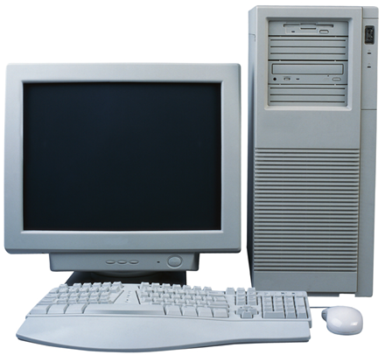
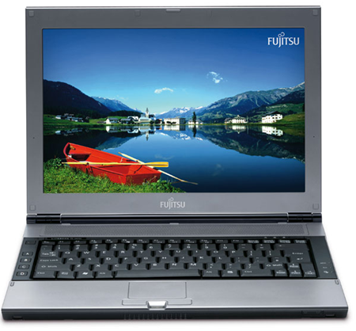
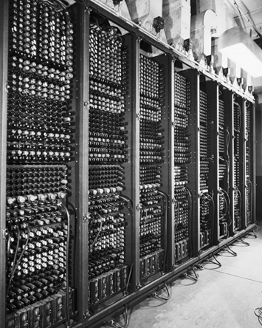
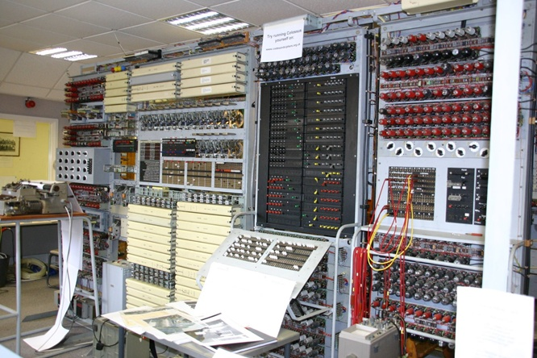
History of Computers

Slide 8
History of Computers
Human Computer Interaction is very frequent in everyday life.
E.g.; Playing game, listening music, checking mails, using MS Word etc etc
First Electronic computer was build in late 1930’s by Dr John & Clifford at Iowa State University.
First large scale Electronic Digital Computer called ENIAC was completed in 1946 at University of Pennsylvania
Weight: 30 tons & occupy 30 by 50 foot space

Slide 9
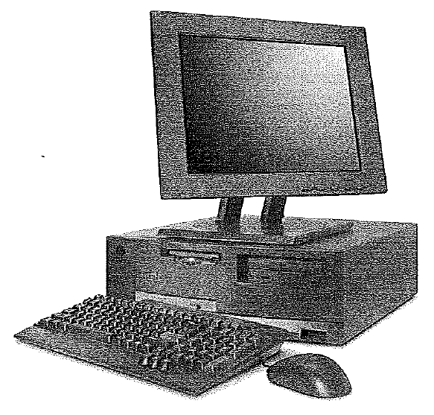
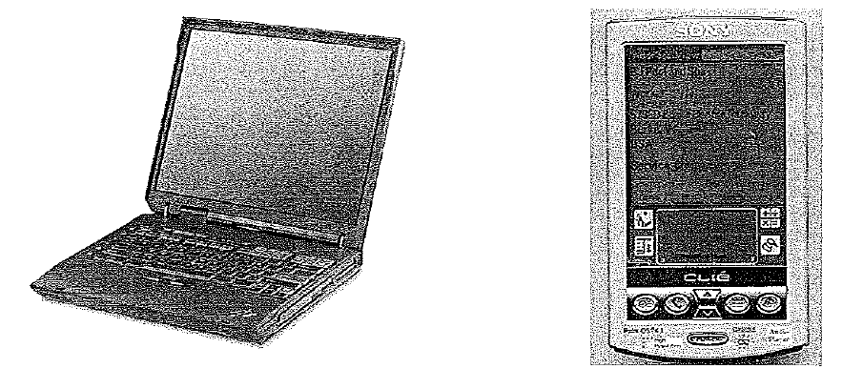
History of Computers
Modern computers are categorized on the basis of size and performance.

Slide 10
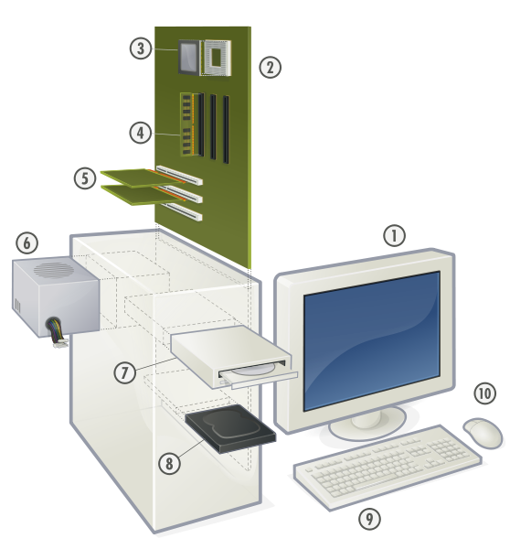
Computer Elements
Hardware
Hardware is equipment used to perform necessary computations and include CPU, monitor, keyborad etc.
Software
Software consists of programs that enable us to solve problems with computers by providing it with list of instructions to perform.

Slide 11
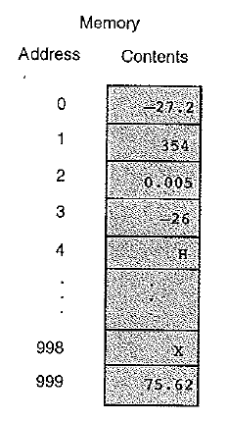

Memory
Imagine the memory of computer as an ordered sequence of storage locations called memory cells.
To store and access information, the computer must have some way of identifying individual memory cells, therefore each memory cell have unique address.
8 bits= 1Byte (Bit is derived from binary digit, 1 or 0)

Slide 12
Computer Software
Computer Software is a collection of computer programs.
S/W ‘s are following two types :
System Software : Systems software is that software which is used to manage computer hardware that enable us to execute and write application programs / software .
For example: Operating Systems, Compilers, Assemblers, Interpreters etc.
Application Software: Application software are those software which are meant for solving users own problems.
For example: Word Processors, Games Programs, Spread Sheets, Data Base Systems, Graphics Programs etc.

Slide 13

What is Computer Program
Computer Programming is the art of making a computer do what you want it to do.
A computer program is simply a set of instructions to tell a computer how to solve a particular problem.

Slide 14
Basics of Computer Programming
It's rather like a recipe:
a set of instructions to tell a cook how to make a particular dish.
It describes the ingredients (the data) and the sequence of steps (the process) needed to convert the ingredients into the cake or whatever.

Slide 15
Programming Language
Just as you speak to a friend in a language so you 'speak' to the computer in a language. The only language that the computer understands is called binary.
Binary is unfortunately very difficult for humans to read or write so we have to use an intermediate language and get it translated into binary for us.

Slide 16
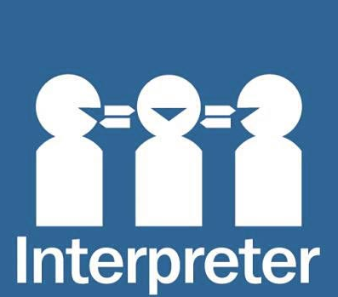
Programming Language
This is rather like watching the American and Russian presidents talking at a meeting.
One speaks in English, then an interpreter repeats what has been said in Russian. The other replies in Russian and the interpreter again repeats the sentence, this time in English.

Slide 17
Programming Language
Surprisingly enough the thing that translates our intermediate language into binary is also called an interpreter.
And just as you usually need a different interpreter to translate English into Russian than you do to translate Arabic into Russian so you need a different computer interpreter to translate Python into binary from the one that translates VBScript into binary.

Slide 18
Machine Code Programming
The very first programmers actually had to enter the binary codes themselves, this is known as machine code programming and is incredibly difficult.
The next stage was to create a translator that simply converted English equivalents of the binary codes into binary so that instead of having to remember that the code 001273 05 04 meant add 5 to 4 programmers could now write ADD 5 4.

Slide 19
Assembler Programming
This very simple improvement made life much simpler and these systems of codes were really the first programming languages, one for each type of computer. They were known as assembler languages and Assembler programming is still used for a few specialized programming tasks today.

Slide 20
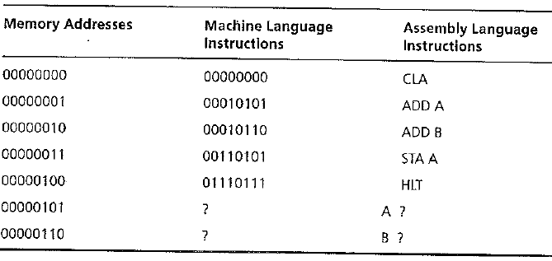

Slide 21
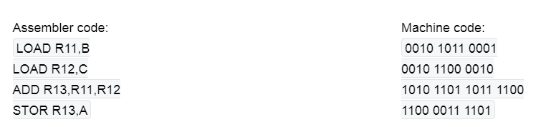
Assembly Code and Machine Code Comparison
Where:
LOAD is the Load instruction
R11 is the working memory location of where to store B,
B is a symbol representing where the storage memory location of B is located.
Notes:
https://knowthecode.io/labs/evolution-of-computing/episode-3

Slide 22
Second Generation High Level Languages
As machines became more powerful, programmers needed more powerful languages. The need to move further away from machine level code grew.
We needed more powerful instruction sets. This is the birth of the high-level language era.

Slide 23
Contd..
In 1954, John Backus, IBM, developed FORTRAN (FORMula TRANslator) , which was released in commercial form in 1957. This language was designed for numerical applications.
Instead of thinking specifically in computer instructions, programmers finally had a more natural, meaningful language

Slide 24
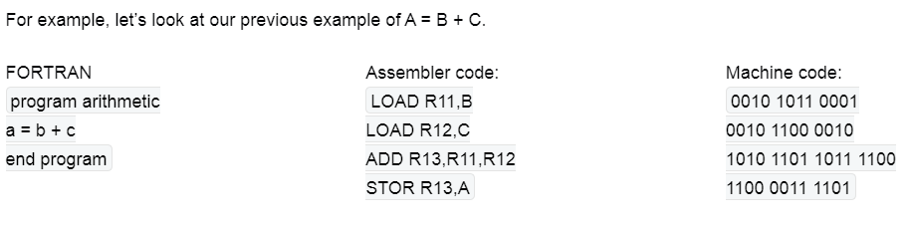
Comparison

Slide 25
Third Generation High Level Languages
High-level languages like FORTRAN, allow us to focus on problem-solving instead of problem solving and machine instructions.
These languages brought new processes such as the compiler, which is the translation software to convert a human-readable language into machine code.
This evolution gives rise to languages like C++, java ,python etc.

Slide 26
Higher level computer languages
Computer scientists developed higher level computer languages to make the job easier. This was just as well because at the same time users were inventing ever more complex jobs for computers to solve!

Slide 27
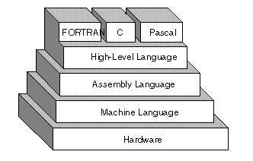
Higher level computer languages
This competition between the computer scientists and the users is still going on and new languages keep on appearing.

Slide 28
What is Compiler/Interpreter ?
Compiler/Interpreter is a System Software which is used to translate higher level language source code into machine code.
For example : C – compiler , FORTRAN compiler.

Slide 29
Compiler and interpreter
A compiler is a translator which transforms source language (high-level language) into object language (machine language)
An Interpreter is a program which imitates the execution of programs written in a source language

Slide 30
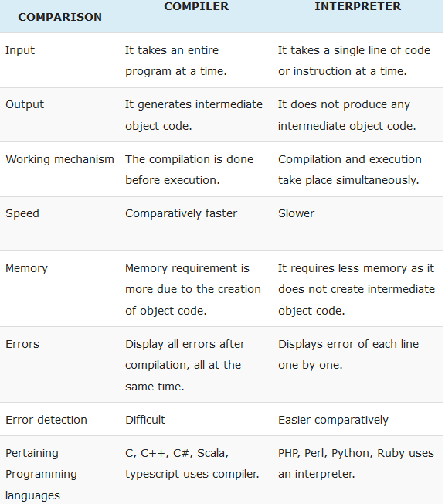
.

Slide 31
Steps for good quality Program/Software development
To develop reliable and good quality Program/ Software we need to follow the following 5 steps :
1. Requirement Specification. 2. Analysis. 3. Design. 4. Implementation. 5. Verification and testing.

Slide 32

For Example:
Take a case study for finding the area and circumference of a circle

Slide 33

Example contd. . . .
1. Problem or Requirement Specification:
Take the radius of a circle from the user and compute and print its area and circumference.

Slide 34
Example contd. . . .
2. Analysis:
Clearly, the problem input is the circle radius.
There are two outputs requested:
the area of circle and
its circumference
From our knowledge of geometry, we know the relationship between the radius of a circle and its area and circumference; we list these formulas along with the data requirements.

Slide 35
Example contd. . . .
Data required: PI 3.14159
Problem Input: Radius
Problem outputs: area , circumference
Relevant Formulas: area of circle = π r² Circumference of circle = 2 π r

Slide 36
Example contd. . . .
3. Design:
Once you know the problem inputs and outputs, you should list the steps necessary to solve the problem .
It is very important that you pay close attention to the order of the steps.

Slide 37
Example contd. . . .
Algorithm : Step1: Get/Input circle radius. Step2: area=PI*radius*radius. Step3: circum= 2*PI*radius. Step4: print area and circumference.

Slide 38
Example contd. . . .
4. Implementation:
In implementation phase we convert our algorithm into actual program using any Programming language which is given in next slide:

Slide 39
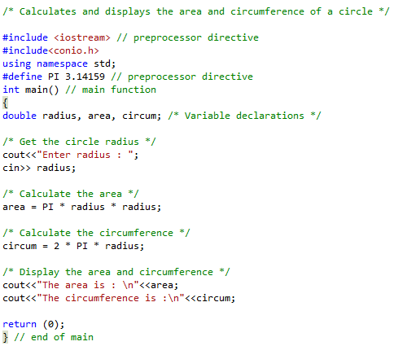

Slide 40
Example contd. . . .
Sample Output : Enter radius : 5.0 The area is : 78.539750 The circumference is : 31.415900

Slide 41
Example contd. . . .
5. Testing:
For testing input different radius values and verify results with standard results.

Slide 42
Task 01
Compute and display the total cost of apples given the number of apples purchased is 10 and cost per apple is 5Rs.

Slide 43
Points to remember
Programs control the computer
Programming languages allow us to 'speak' to the computer at a level that is closer to how humans think than how computers 'think'

Slide 44
Points to remember
Basically a programmer writes a program in a high level language which is interpreted into binary that the computer understands.
In technical speak the programmer generates source code and the interpreter generates object code. Sometimes object code has other names like: binary code or machine code.

Slide 45
Points to remember
Think like a programmer
Have you seen the State Farm commercials where the car wash company returns the cars to customers with the soap suds still on the car? The company washes the car, but it didn't rinse it. This is a perfect metaphor for computer programs. Computers, like that car wash company, are very very literal. They do exactly, and only, what you tell them to do; they do not understand implicit intentions. The level of detail required can be daunting at first because it requires thinking through every single step of the process, making sure that no steps are missing.

Slide 46
Questions??

